Slide 1
Chef - basics
Presented By – Nidhi Mehta

Slide 2
Agenda
Overview of Chef
Chef Components
Chef Terminology
Cookbooks, Recipes, Resources & Providers
Roles, Run Lists, & Attributes
Attribute Precedence
Search & Data Bags
Ohai
Chef Convergence
Running Chef

Slide 3

An Overview of Chef
Chef is a systems and cloud infrastructure automation framework that makes it easy to deploy servers and applications to any physical, virtual, or cloud location, no matter the size of the infrastructure
Chef is built to address the hardest infrastructure challenges. By modeling IT infrastructure and application delivery as code
Chef is a configuration management tool written in Ruby and Erlang. It uses a pure-Ruby, domain-specific language (DSL) for writing system configuration "recipes"

Slide 4
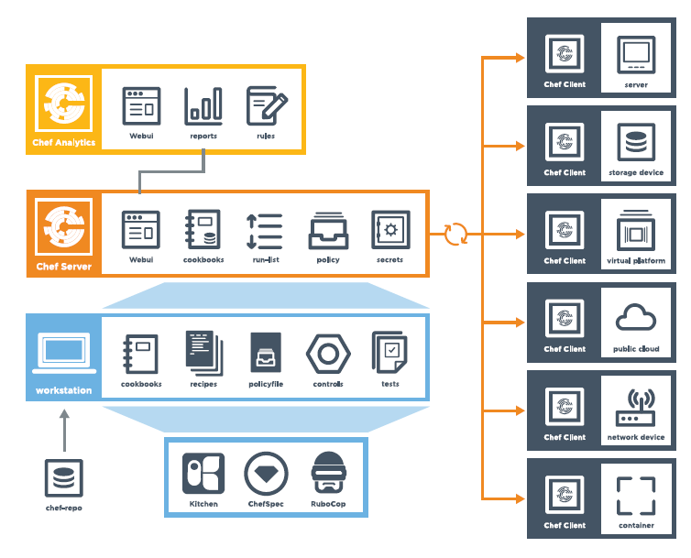
Chef Components

Slide 5
Contd..
Chef comprises three main elements: a server, one (or more) nodes, and at least one workstation.
The server acts as a hub that is available to every node in the organization. This ensures that the right cookbooks (and recipes) are available, that the right policies are being applied, that the node object used during the previous chef-client run is available to the current chef-client run, and that all of the nodes that will be maintained by the chef-client are registered and known to the server.
The workstation is the location from which cookbooks (and recipes) are authored, policy data (such as roles, environments, and data bags) are defined, data is synchronized with the chef-repo, and data is uploaded to the server.
Each node contains a chef-client that performs the various infrastructure automation tasks that each node requires.

Slide 6
Contd..
Each node contains a chef-client that performs the various infrastructure automation tasks that each node requires.
Cookbooks are also a very important element of Chef and will be treated as a separate component (alongside the server, nodes, and the workstation) across the documentation.
In general, the cookbooks are authored and managed from the workstation, moved to the Chef server, and then are pulled down to nodes by the chef-client during each Chef run.

Slide 7
Chef Terminology
Term | Meaning
Node | Server on which Chef is run.
Run-list | The list of recipes/roles assigned to a particular node.
Role | Functional grouping of cookbooks e.g. the web_server role may include the Apache recipe followed by the firewall configuration recipe.
Environment | Logical grouping of nodes. E.g. production, test, development. May specify cookbook version constraints.
Convergence | The process of bringing the node to the correct state by executing the any new or changed recipes assigned to the node.
Knife | Command-line tool for interacting with Chef and automating various tasks.

Slide 8
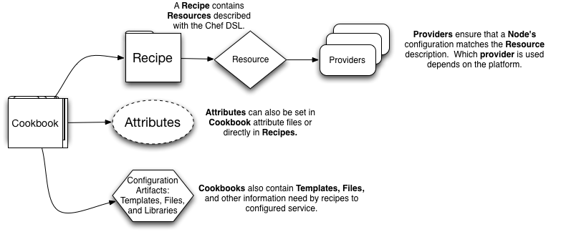
Cookbooks, Recipes, Resources & Providers
Cookbooks are the way Chef users package up, distribute, and share configuration information. They encapsulate all the resources needed to automate your infrastructure, and are easily sharable with other Chef users as well. They contain recipes, attribute files, templates, and other configuration artifacts.
When Chef-Client runs, recipes listed in the node's run list are transferred to the node, along with the other contents of the cookbook containing the recipe. These recipes are then applied to the node, bringing it into the proper configuration.
Typically, a single cookbook contains the information necessary to configure a single service or single part of the system. For instance, one may have a "users" cookbook for configuring the users who should have access to the system and an "apache" cookbook for configuring the apache web server.

Slide 9
Contd..
Recipes are Ruby files in which you use Chef's Domain Specific Language (DSL) to define how particular parts of a node should be configured.
Resources are the building blocks you will use to create a properly configured node.
The actual creation is performed by a Provider which executes the necessary commands.
Attributes provide a nested key-value store of data about a node and its configuration.
A Template is a feature of Chef that allows you to create general files whose contents can be generated dynamically

Slide 10
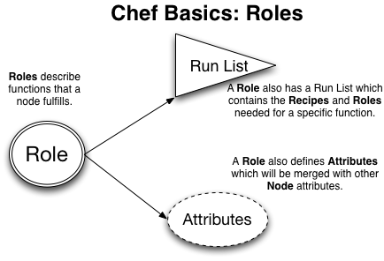
Roles, Run Lists, & Attributes
Roles contain a run list (just like a node) and attributes pertaining to a specific function.
Environments in Chef provide a mechanism for managing different environments such as production, staging, development, and testing, etc. within one Chef Server organization.

Slide 11
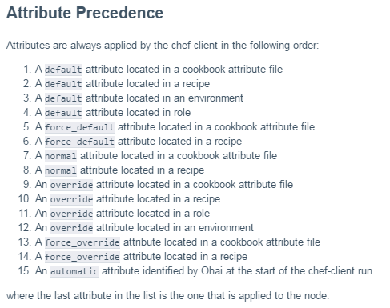
Attribute Precedence

Slide 12
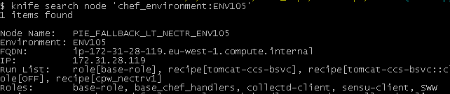
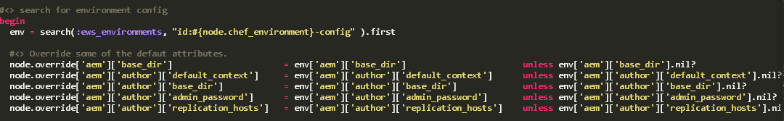
Search & Data Bags
Search allows you to query information about your infrastructure from within a recipe or via knife.
Data bags allow you to store data in a searchable fashion. This data is then searchable and can be used within recipes.

Slide 13
Ohai
Chef comes with an inbuilt tool called Ohai
Ohai generates attributes from the node
Standard generated attributes include:
Kernel type and version
Hardware configuration (# of CPUs and architecture)
Network information
Run before any attributes are calculated

Slide 14
Chef Convergence
The process of bringing the node to the correct state by executing the any new or changed recipes assigned to the node.
Follows the high level process:
Step 1: Run Ohai to generate the local attributes
Step 2: Read attribute values from cookbooks/roles/environments
Step 3: Process the run-list to run the required recipes

Slide 15
Running Chef
Chef has two means of converging a node as detailed in this slide
Chef Solo
Standalone command line tool
Run-list, roles, environment and node-specific attributes specified in the command line
Requires additional tooling to manage larger numbers of environments
Chef Server & Chef Client
Cookbooks/roles/environments are uploaded to a Chef Server
Chef Client downloads configuration for the node and performs convergence on a periodic basis
Default is to automatically run every 30 mins (poll time can be configured)

